Slide 1




GROUP PROJECT
CMPG 315

Slide 2
OUR TEAM
TABLE OF CONTENTS
PROJECT OVERVIEW
PACKET TRACER
MESSAGE APP
BUDGET

Slide 3
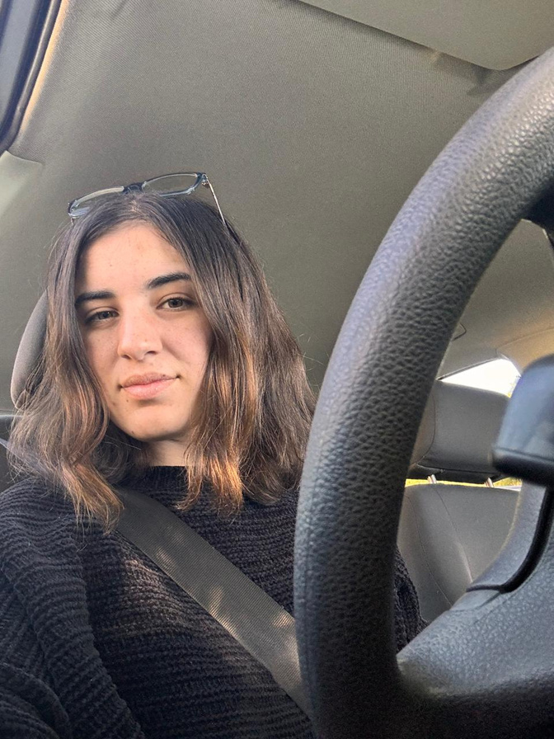
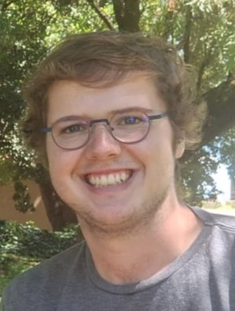
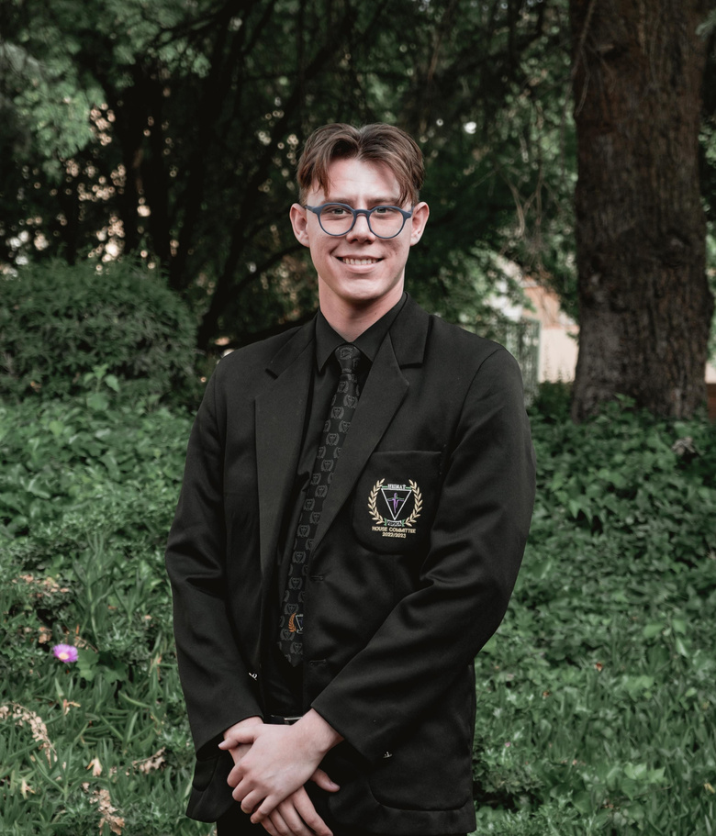
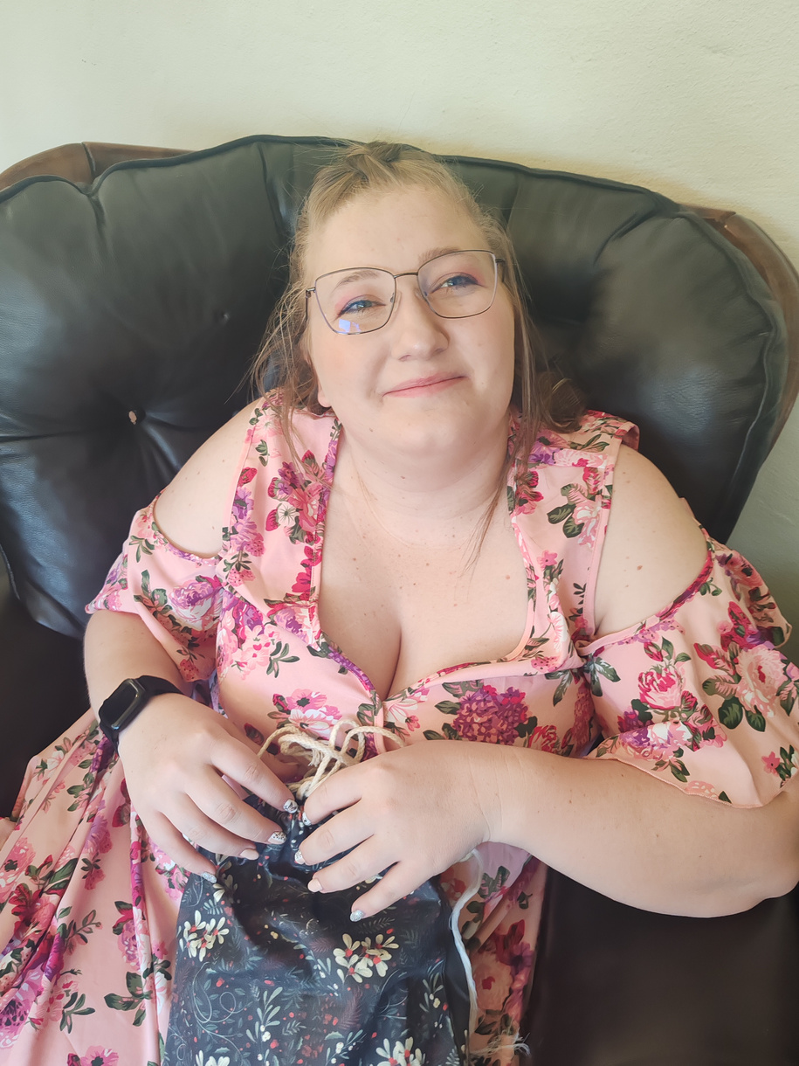
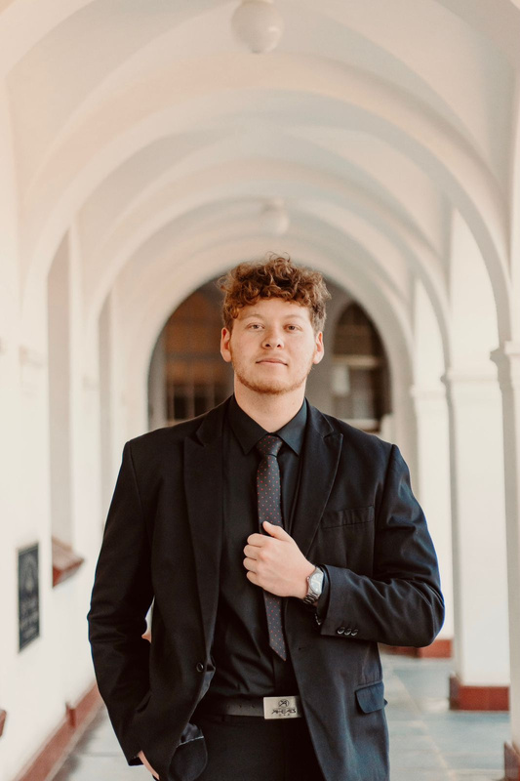
Mariska Adriaanzen
Group Leader
Cecilia Theunissen
Packet Tracer Expert
Christoffel Schoeman
Code Buff
Ethan Sutherland
GUI Mastermind
Marnus De Beer
Administrator
OUR TEAM

Slide 4
PROJECT OVERVIEW
Assumptions
Cisco Packet Tracer
Remote access sloution
Budget
Messaging app
Issues

Slide 5

ASSPUMPTIONS

Slide 6
Packet Tracer
9 VLAN
VLANs has a range corresponding to the VLAN
2960 for core switch and machine room switches
Budget
Budget limit is 1 million
Easier to make it online rather than local
Python and hosted on Render Cloud Application Platform
Chat App

Slide 7
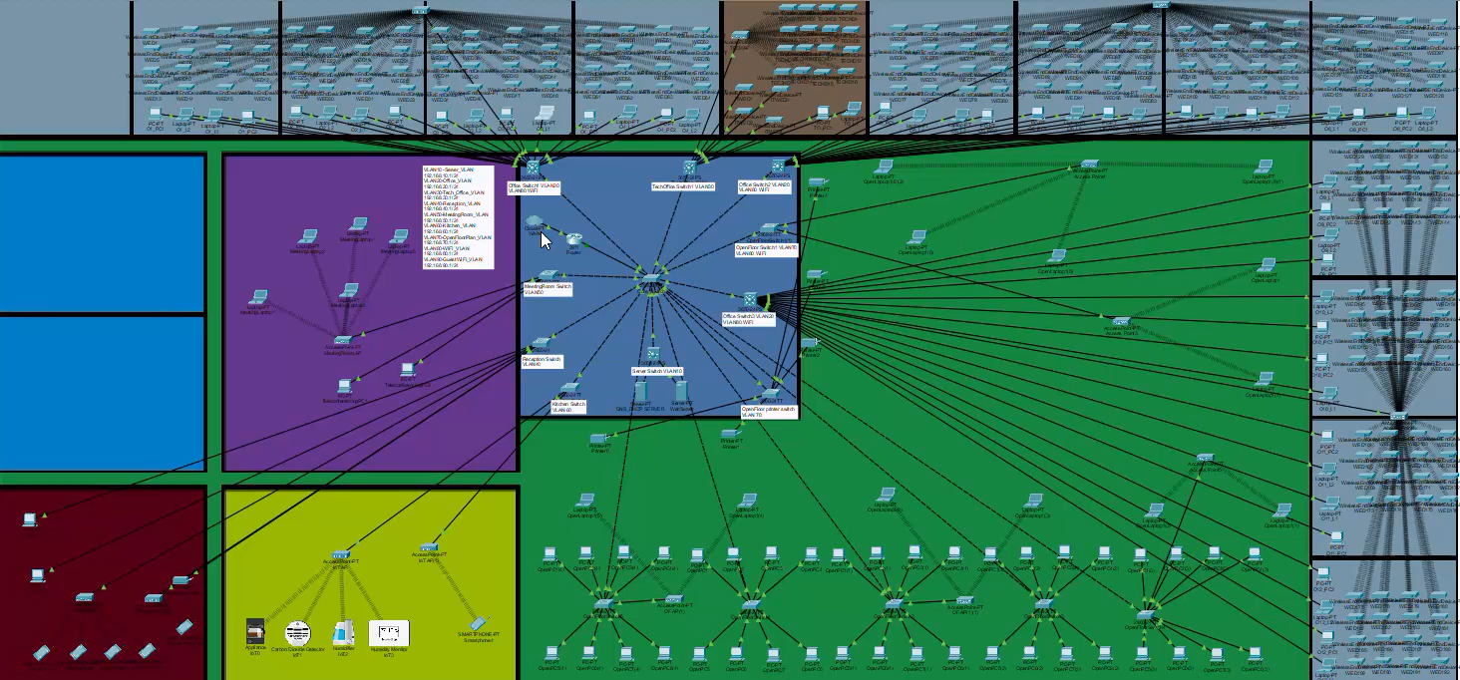
PACKET TRACER

Slide 8

Remote Access solution
Anydesk

Slide 9

BUDGET

Slide 10
Devices | Quantity | Price (R) | Total (R)
Switches (33650- 24ps) | 12 | 2,000.00 | 24,000.00
Router (2911) | 1 | 1,500.00 | 1,500.00
Copper Straight Through Cable (100m) | 6 | 300.00 | 1,800.00
Access Point | 15 | 2,500.00 | 37,500.00
Labour | 126 | 450.00 | 56,700.00
AnyDesk | 1 | 1244.48 | 1,244.48
Total |  |  | 121,500.00

Slide 11

MESSAGING APP

Slide 12
Server
Render free
Booting up may take a while
3 Imports
Flask
Flask-Socketio
eventlet
GUI
2 Imports
image
imageTk

Slide 13




Questions?
Thank You!

